Slide 1
STOCK MANAGEMENT SOFTWARE
-oswal info world pvt ltd

Slide 2
PURPOSE
For reducing paper use,go green.
Fast procesing of information.
Automation of office system.
Smart Working.

Slide 3
FEATURES
Id and password for security.
Manage customer and supplier details.
Well handle sales and purchase.
Viewing payment outstanding of customer and suppiler.
Adding new stock and viewing present stock.
Three type of reports generation.

Slide 4
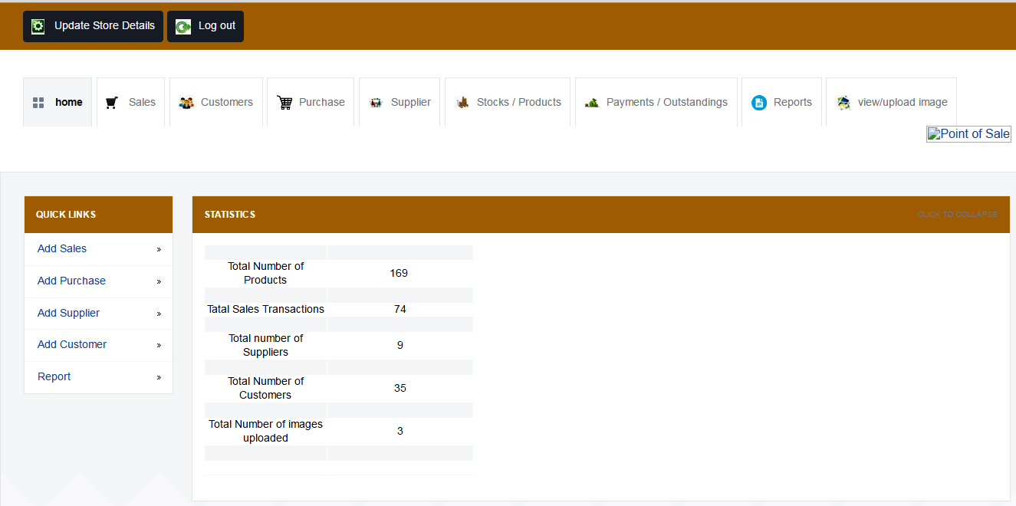
HOMEPAGE
All shortcuts of software has placed in one place

Slide 5
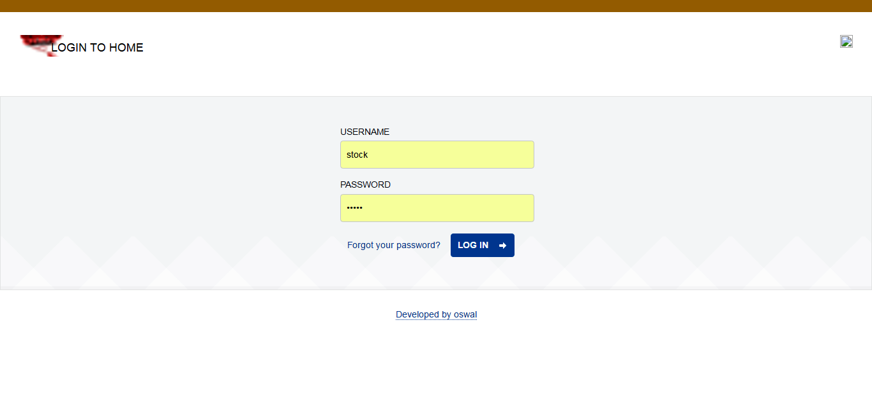
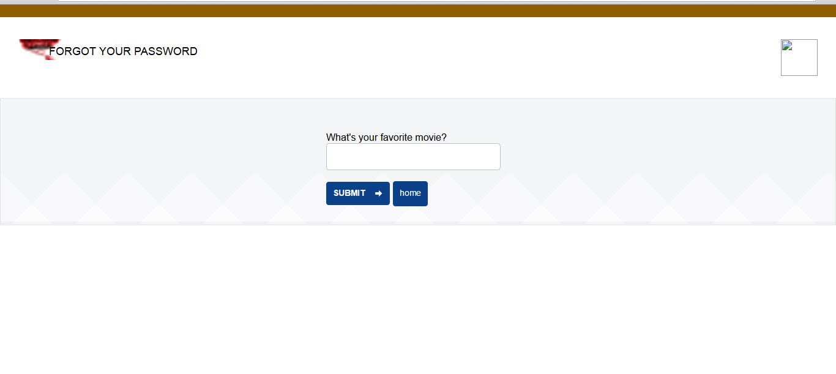
LOGIN PANEL
In our software id & password are given and if user forget password then recovery if given

Slide 6
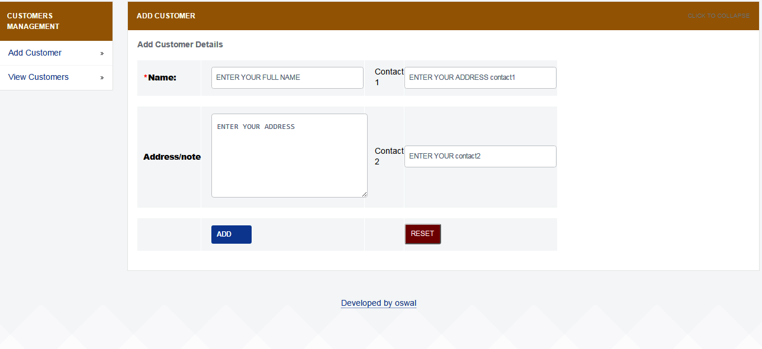
CUSTOMER ADDING NEW CUSTOMER
We can add new customer add

Slide 7
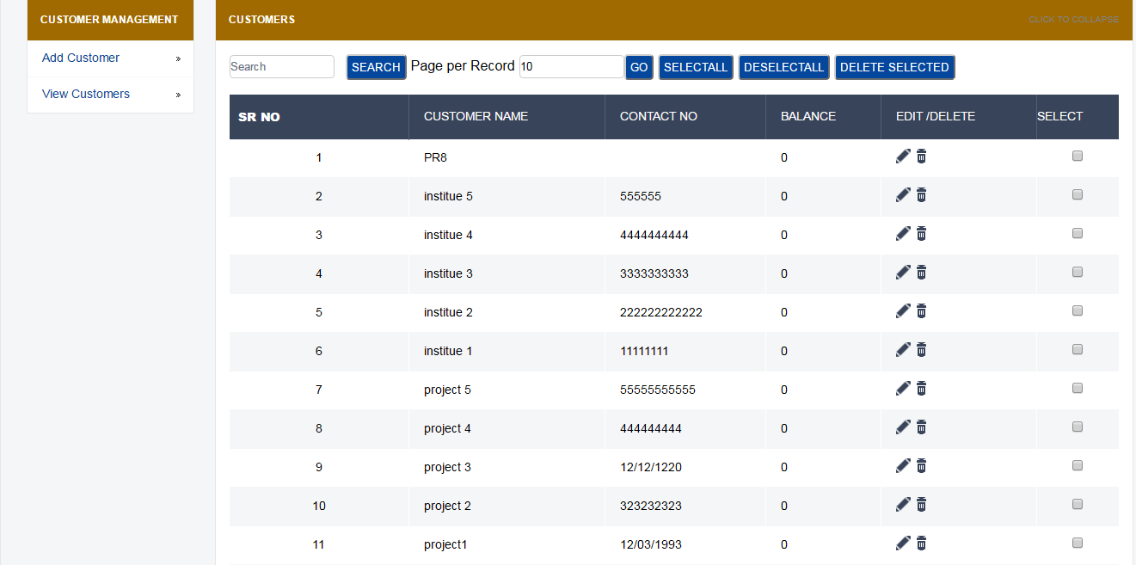
CUSTOMER VIEW CUSTOMER
And can view added customer and edit also

Slide 8
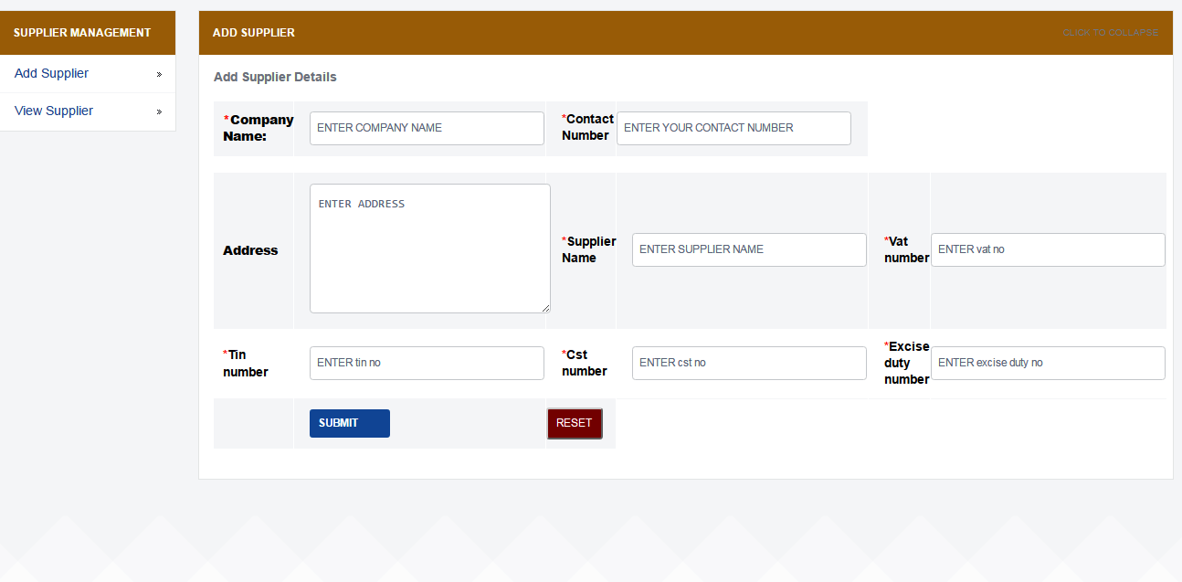
SUPPLIER ADD NEW SUPPLIER
Here we can add new supplier details and can maintain as record.

Slide 9
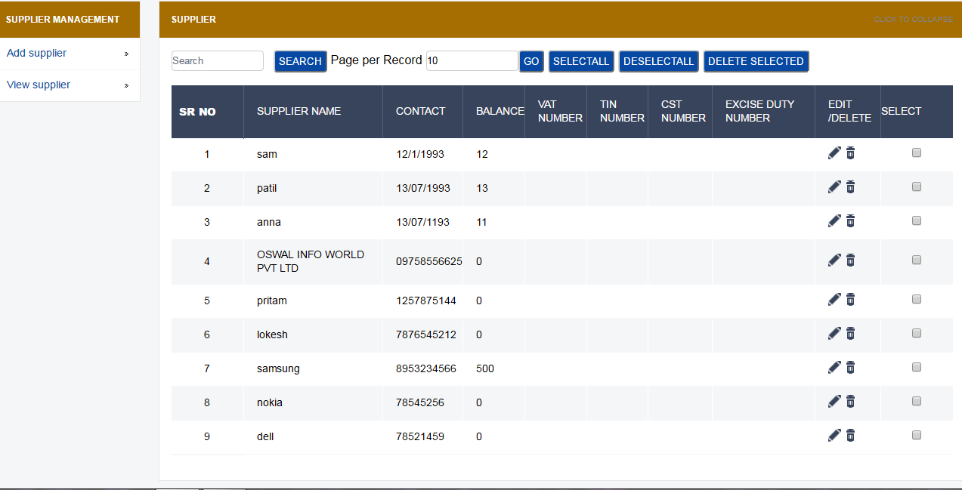
SUPPLIER VIEW SUPPLIER
In this supplier details are shown and can edit and serach

Slide 10
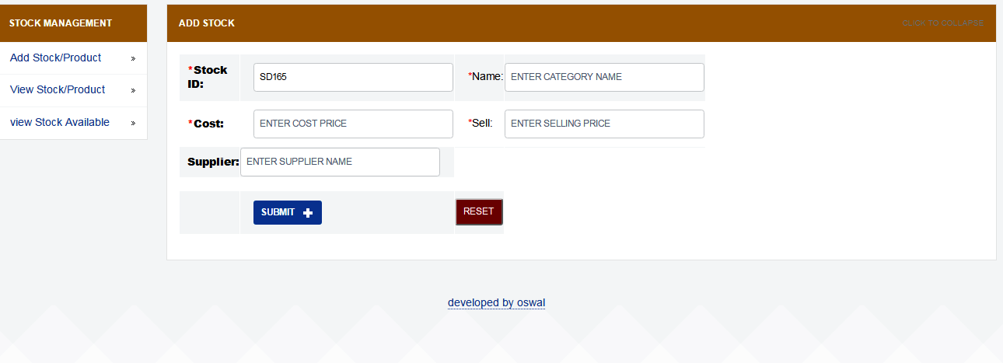
STOCK/ ITEM ADDING NEW STOCK
In this we can add new item,cp,sp in our stock .

Slide 11
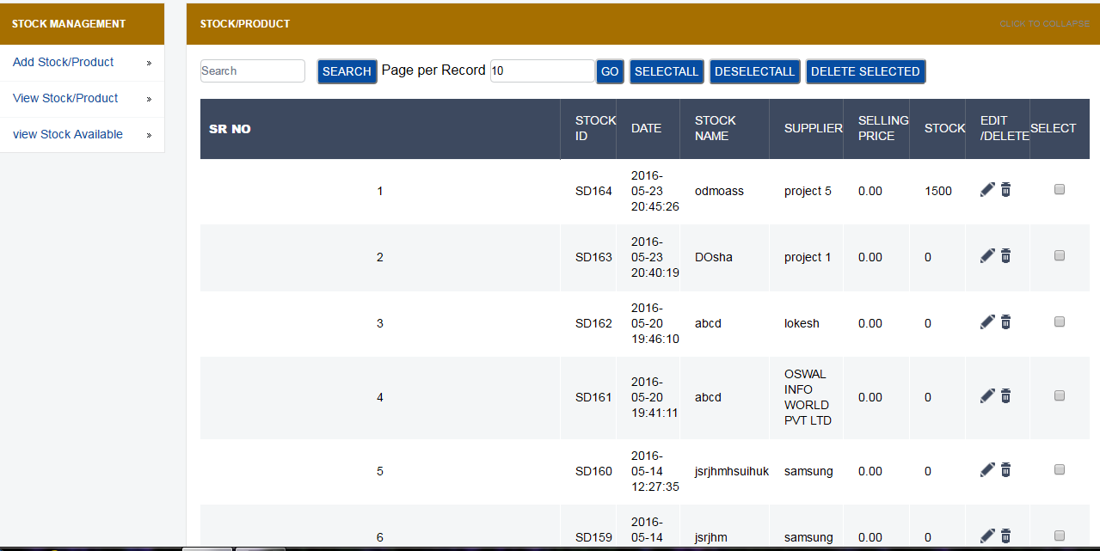
STOCK/ ITEM VIEW STOCK
Viewing all stock and edit and delete as neede.

Slide 12
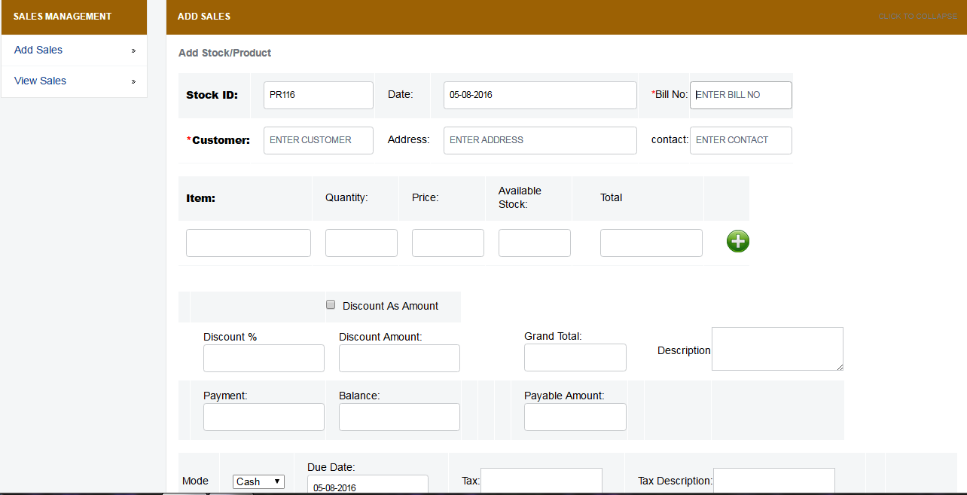
SALES ADD NEW SALES
In this new sales for customer has been added and item needed by customer

Slide 13
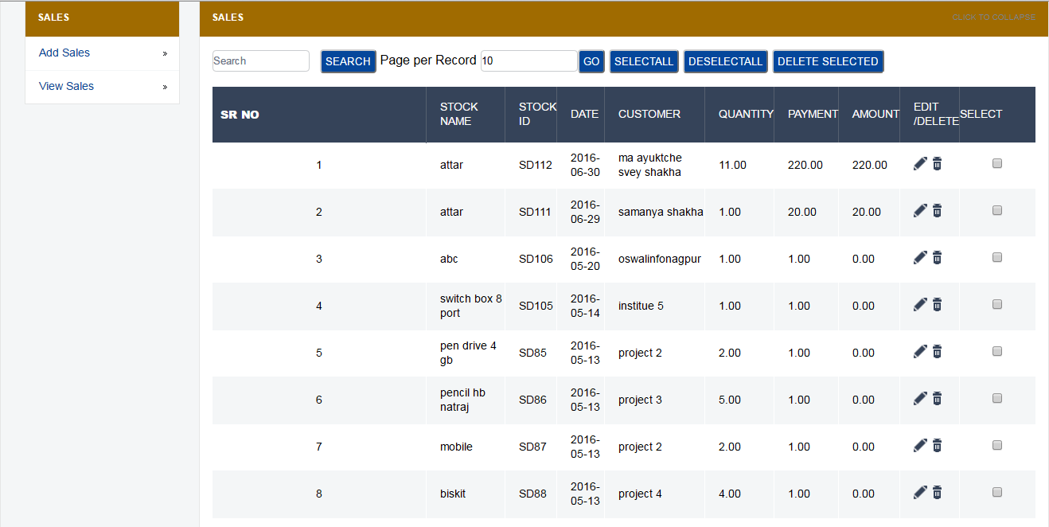
SALES VIEW SALES
Here the demand needed by customer has been viewed.

Slide 14
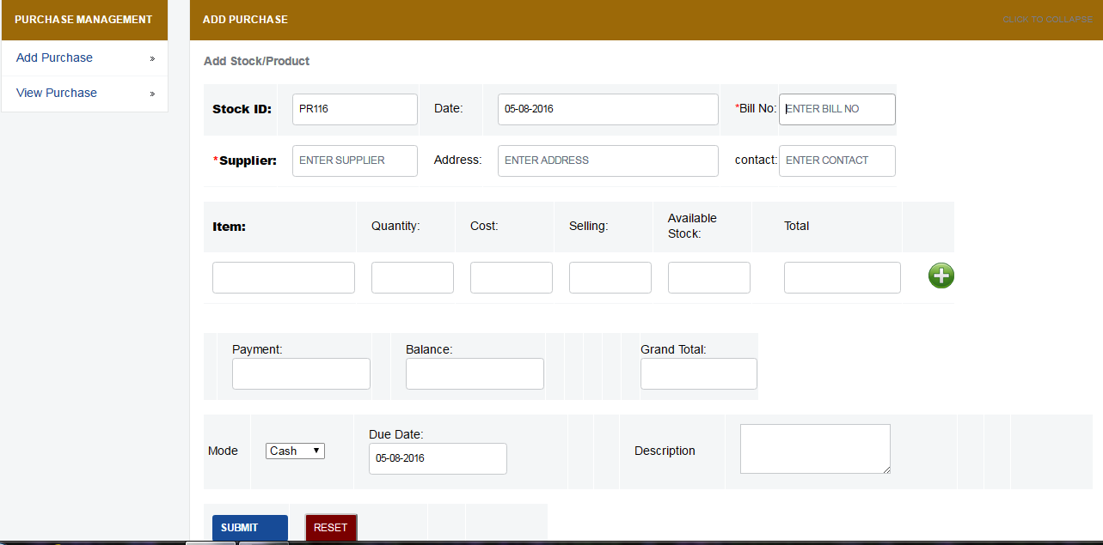
PURCHASE ADD NEW PURCHASE
In case if stock goes low then add new stock here.

Slide 15
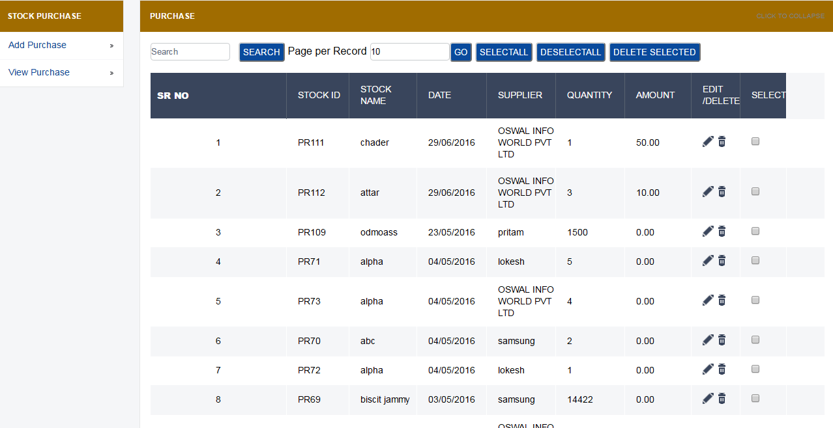
PURCHASE VIEW PURCHASE
In this the stock purchase from supplier can be view.

Slide 16
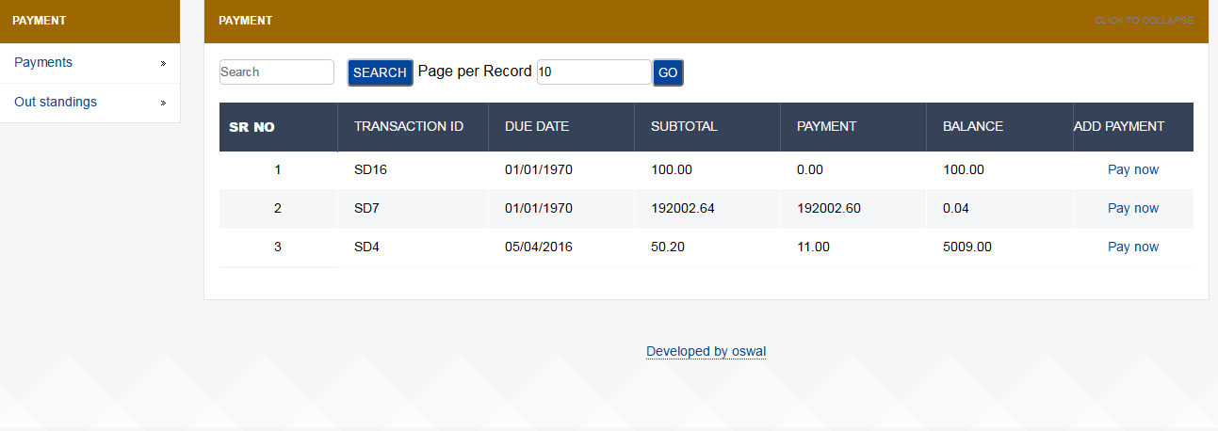
PAYMENT
We can see payment and outstanding details of supplier.

Slide 17
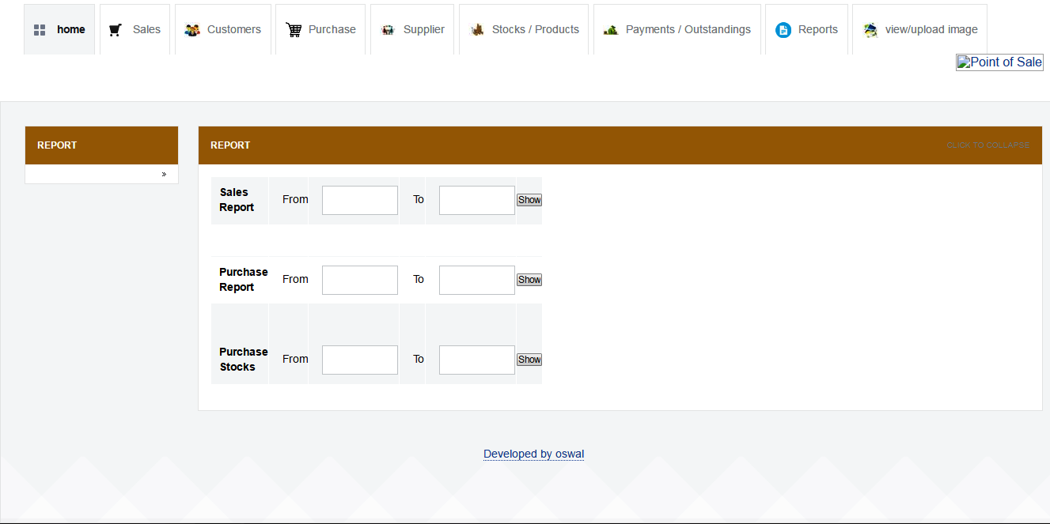
REPORTS
Here three types of reports can be generated.

Slide 18
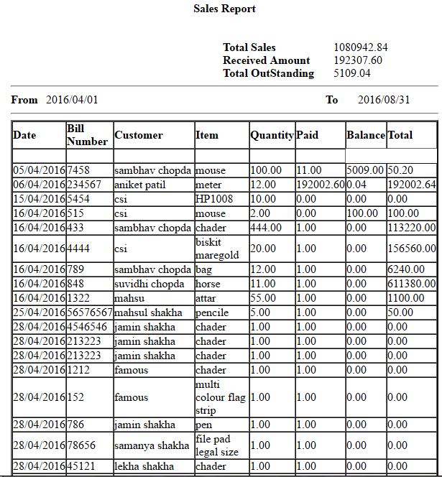
REPORTS-1 SALES REPORT

Slide 19
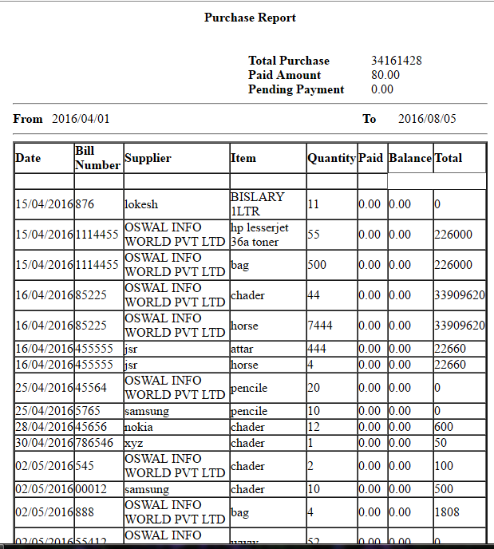
REPORTS-2 PURCHASE REPORT

Slide 20
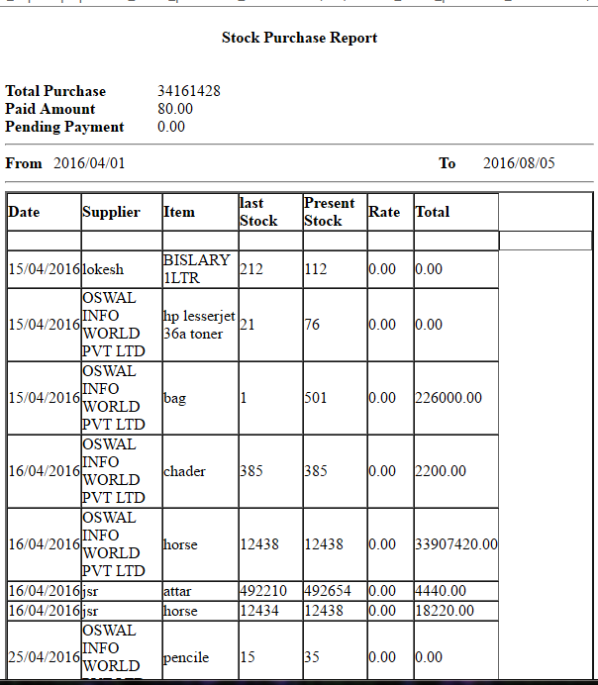
REPORTS-3 STOCK PURCHASE REPORT

Slide 21
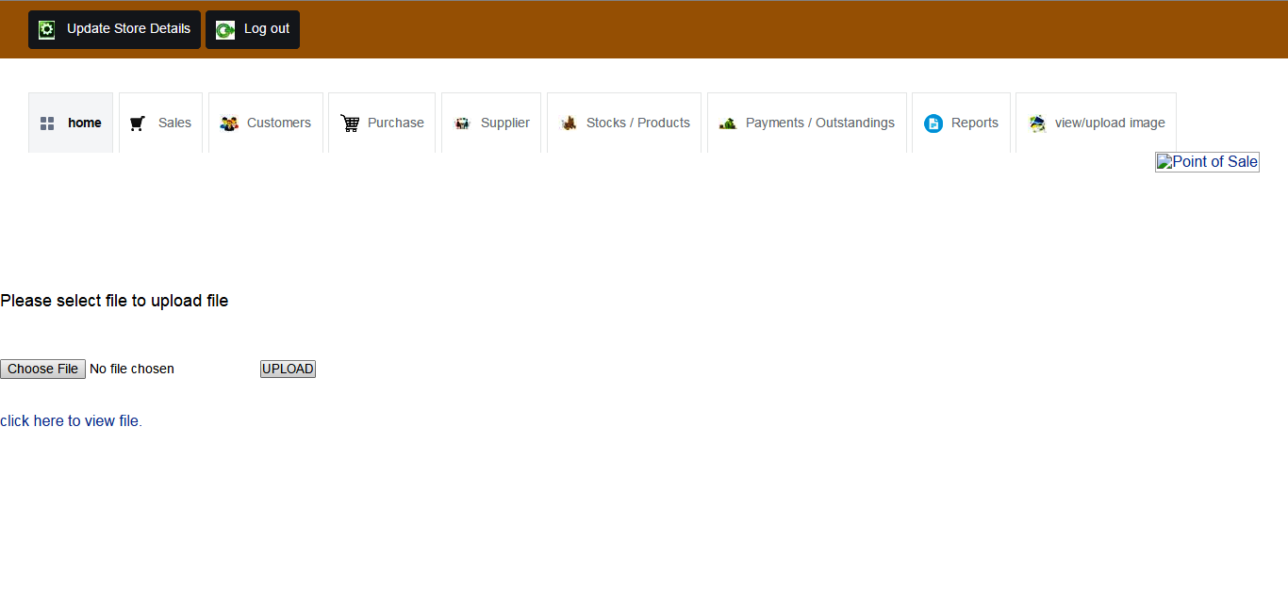
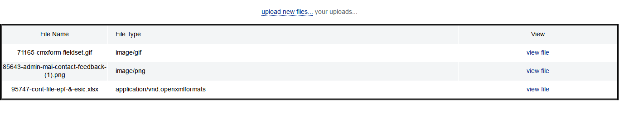
UPLOADING SCAN DOC

Slide 22
FINAL LOOK
In all module we can search,edit,delete.
Store details can be updated.
Password recovery.
Monthly or daily reports can be generated.

Slide 23
TAHNK YOU

